Slide 1
Understanding the Big Picture
an overview of things to come

Slide 2

DevOps Overview
DevOps is a mindset, a way of thinking
The goal of all DevOps organizations are the same
What began an experiment has transformed into a movement
Notes:
DevOps is a mindset, a way of thinking,
versus a set of processes implemented in a specific way.
The goal of all DevOps organizations are the same:
to improve the quality and speed at which innovation is delivered.
SHARE:
What began an experiment has transformed into a movement
to bring together software development and the operations to run the software closer together.
Over the years, industry leaders and DevOps practitioners have come together to identify patterns and best practices so that successful methods are shared to the next wave of DevOps practitioners.
SOURCE: https://www.docker.com/sites/default/files/WP_Docker%20and%20the%203%20ways%20devops_07.31.2015%20%281%29.pdf

Slide 3

What is This Docker Thing?
A company?
A format?
An API?
Framework?
Or, maybe something in the Cloud!
Notes:
Overview
Docker is the world’s leading software container platform.
Developers use Docker to eliminate “works on my machine” problems when collaborating on code with co-workers.
Operators use Docker to run and manage apps side-by-side in isolated containers to get better compute density.
Enterprises use Docker to build agile software delivery pipelines to ship new features faster, more securely and with confidence for both Linux and Windows Server apps.

Slide 4
Docker Platform
The Docker Platform is the only platform of it’s kind
Docker Community Edition [CE] empowers developers with tools to build apps
Docker Enterprise Edition [EE] provides IT with multi-architecture operations at scale
It’s important to remember to pay attention to whether we are talking about EE or CE, during our lectures
Both fundamentals are the same, but each does thing the other doesn’t
Notes:
The Docker platform is the only container platform to build, secure and manage the widest array of applications from development to production both on premises and in the cloud.
Docker Community Edition [CE] empowers developers with tools to build applications
and Docker Enterprise Edition [EE] provides IT with multi-architecture operations at scale.
SHARE:
Docker delivers both an engine for innovation that modernizes without disruption while reducing total costs by more than 50%. Unlike other solutions that specialize in a narrow slice of the enterprise IT portfolio, Docker delivers operations at scale by addressing a diverse set of applications and infrastructure for both developers and IT.

Slide 5
Docker Platform
Docker tries to maintain these three values:
Simplicity
Docker makes powerful tools for application creation and orchestration, accessible to everyone
Openness
Built with open source technology and a modular design makes it easy to integrate into your existing environment
Independence
Docker creates a separation of concerns between developers and IT and between applications and infrastructure to unlock innovation
Notes:
When you think Docker, think:
Simplicity
Docker makes powerful tools for application creation and orchestration, accessible to everyone.
Openness
Built with open source technology and a modular design makes it easy to integrate into your existing environment.
Independence
Docker creates a separation of concerns between developers and IT and between applications and infrastructure to unlock innovation.

Slide 6

Docker Engine
At the core of this thing we call Docker, is the Docker Engine
Docker Engine is a client-server application with these major components:
Notes:
Docker Engine
Docker Engine is a client-server application with these major components:
1. A server which is a type of long-running program called a daemon process (the dockerdcommand).
2. A REST API which specifies interfaces that programs can use to talk to the daemon and instruct it what to do.
A command line interface (CLI) client (the docker command).
3. The CLI uses the Docker REST API to control or interact with the Docker daemon through scripting or direct CLI commands. Many other Docker applications use the underlying API and CLI.
The daemon creates and manages Docker objects, such as images, containers, networks, and volumes.
Note: Docker is licensed under the open source Apache 2.0 license.
For more details, see Docker Architecture below.

Slide 7
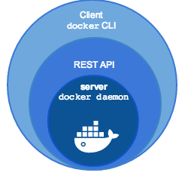

Docker Engine
A server which is a type of long-running program called a daemon process
Notes:
1. A server which is a type of long-running program called a daemon process (the dockerdcommand).
SHARE:
The daemon creates and manages Docker objects, such as images, containers, networks, and volumes.
Note: Docker is licensed under the open source Apache 2.0 license.
For more details, see Docker Architecture below.

Slide 8
Docker Engine
A REST API which specifies interfaces that programs can use to talk to the daemon and instruct it what to do
Notes:
2. A REST API which specifies interfaces that programs can use to talk to the daemon and instruct it what to do.
Note: Docker is licensed under the open source Apache 2.0 license.
For more details, see Docker Architecture below.

Slide 9
Docker Engine
A command line interface (CLI) client (the docker command)
Notes:
3. A command line interface (CLI) client (the docker command).
SHARE:
The CLI uses the Docker REST API to control or interact with the Docker daemon through scripting or direct CLI commands. Many other Docker applications use the underlying API and CLI.
Note: Docker is licensed under the open source Apache 2.0 license.
For more details, see Docker Architecture below.

Slide 10
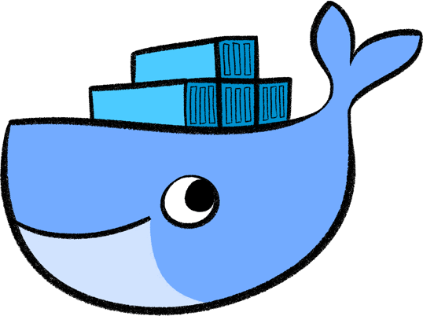
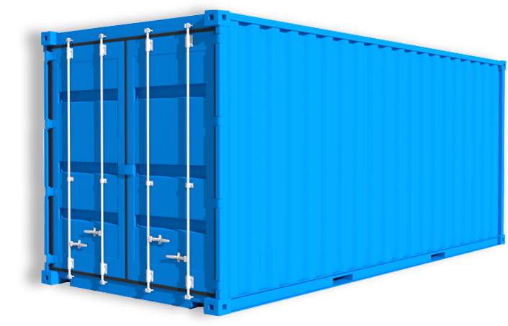
What is Docker?
Googles says:
“Docker is an open-source project that automates the deployment of applications inside software containers.”
Quote from Docker:
“Docker provides an additional layer of abstraction and automation of operating-system-level virtualization on Linux.”
All about
containers!
Powered by Virtuant © 2016

Slide 11
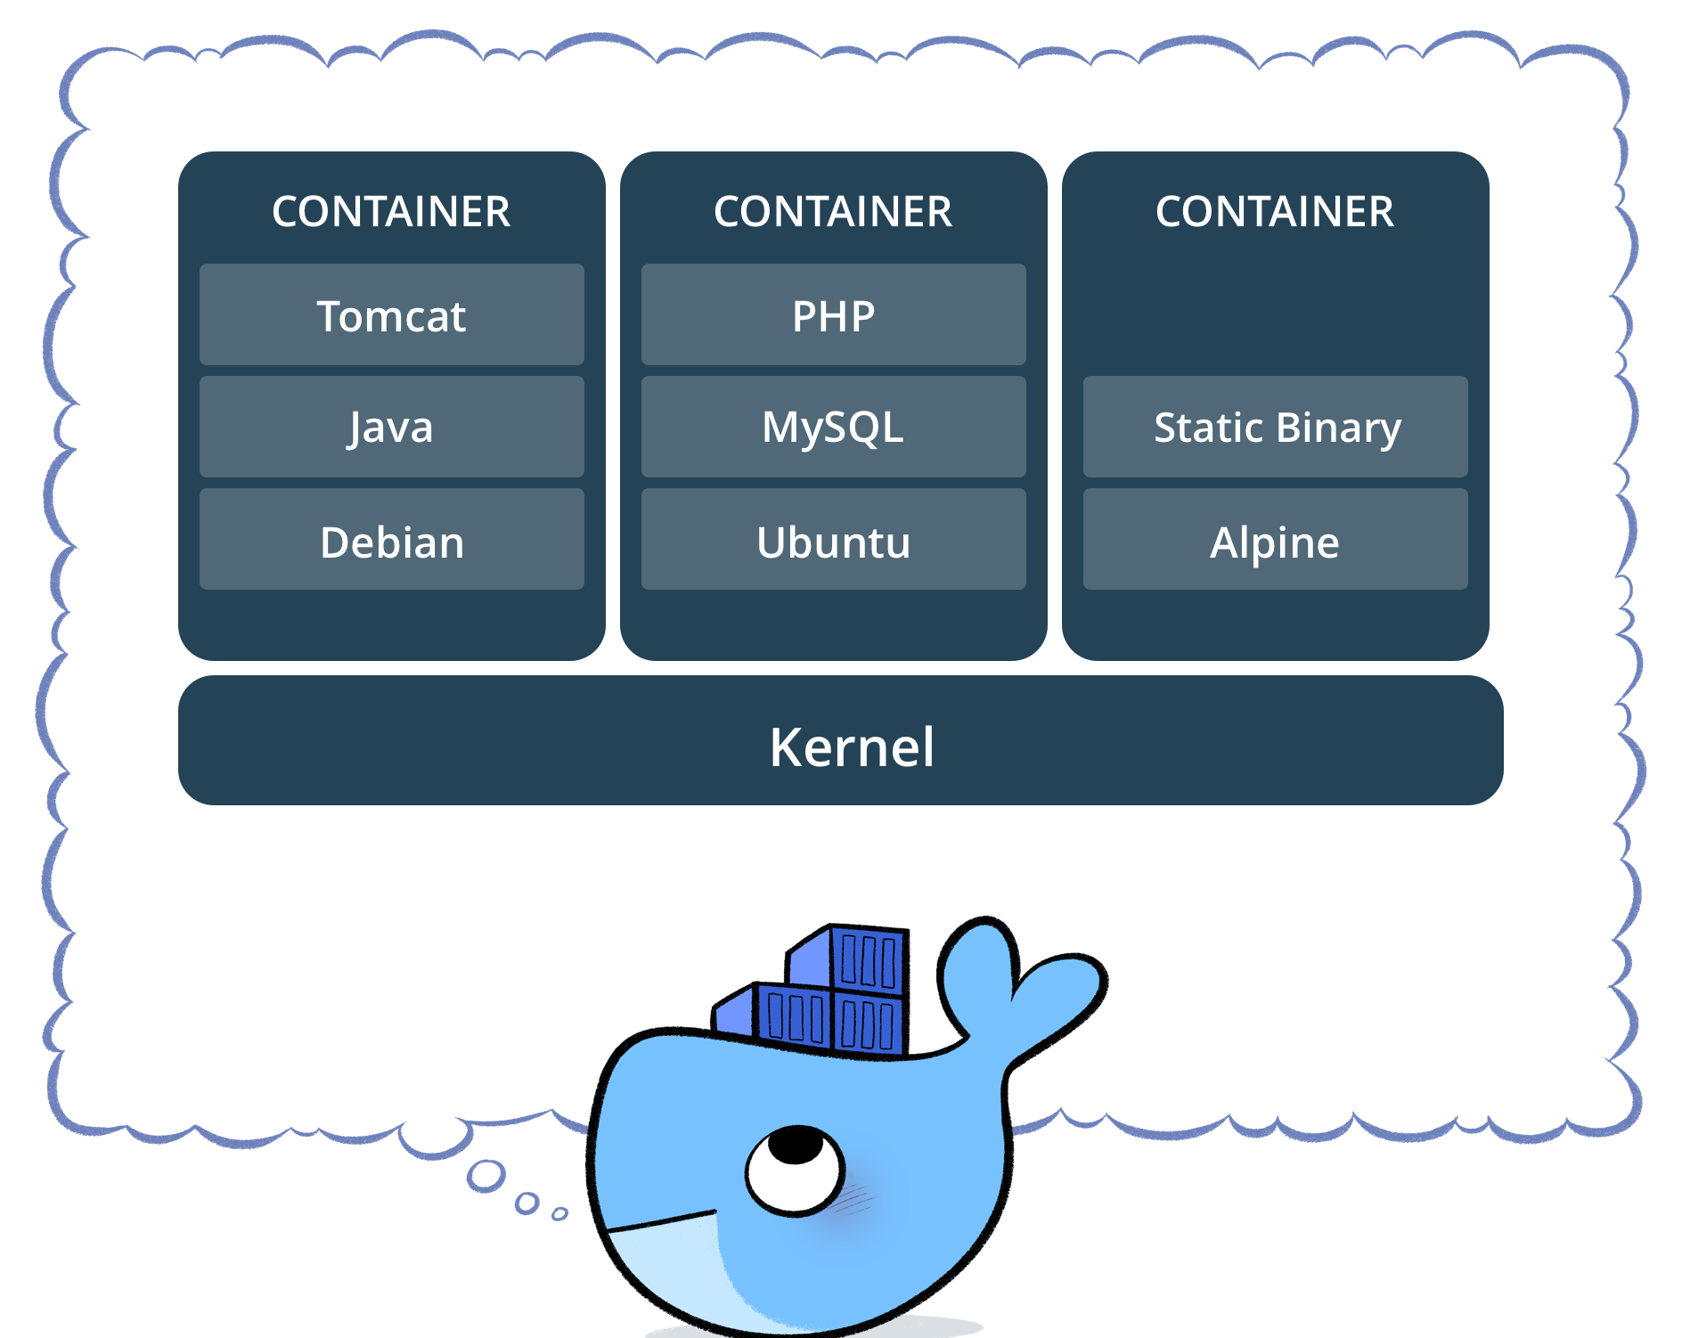
What Are Containers?
A container is a lightweight, stand-alone, executable package
It includes everything needed to run!
Containerized software always runs the same, regardless of the environment
Containers isolate software from its surroundings
Notes:
What Are Container?
A container image is a lightweight, stand-alone, executable package of a piece of software
that includes everything needed to run it:
code, runtime, system tools, system libraries, settings.
Available for both Linux and Windows based apps,
containerized software will always run the same, regardless of the environment.
Containers isolate software from its surroundings,
for example differences between development and staging environments and help reduce conflicts between teams running different software on the same infrastructure.

Slide 12
What Are Containers?
Lightweight:
Docker containers running on a single machine share that machine's operating system kernel; they start instantly and use less compute and RAM. Images are constructed from filesystem layers and share common files. This minimizes disk usage and image downloads are much faster
Standard:
Docker containers are based on open standards and run on all major Linux distributions, Microsoft Windows, and on any infrastructure including VMs, bare-metal and in the cloud
Secure:
Docker containers isolate applications from one another and from the underlying infrastructure. Docker provides the strongest default isolation to limit app issues to a single container instead of the entire machine
Notes:
LIGHTWEIGHT
Docker containers running on a single machine share that machine's operating system kernel; they start instantly and use less compute and RAM. Images are constructed from filesystem layers and share common files. This minimizes disk usage and image downloads are much faster.
STANDARD
Docker containers are based on open standards and run on all major Linux distributions, Microsoft Windows, and on any infrastructure including VMs, bare-metal and in the cloud.
SECURE
Docker containers isolate applications from one another and from the underlying infrastructure. Docker provides the strongest default isolation to limit app issues to a single container instead of the entire machine.
https://www.docker.com/what-container#/virtual_machines

Slide 13
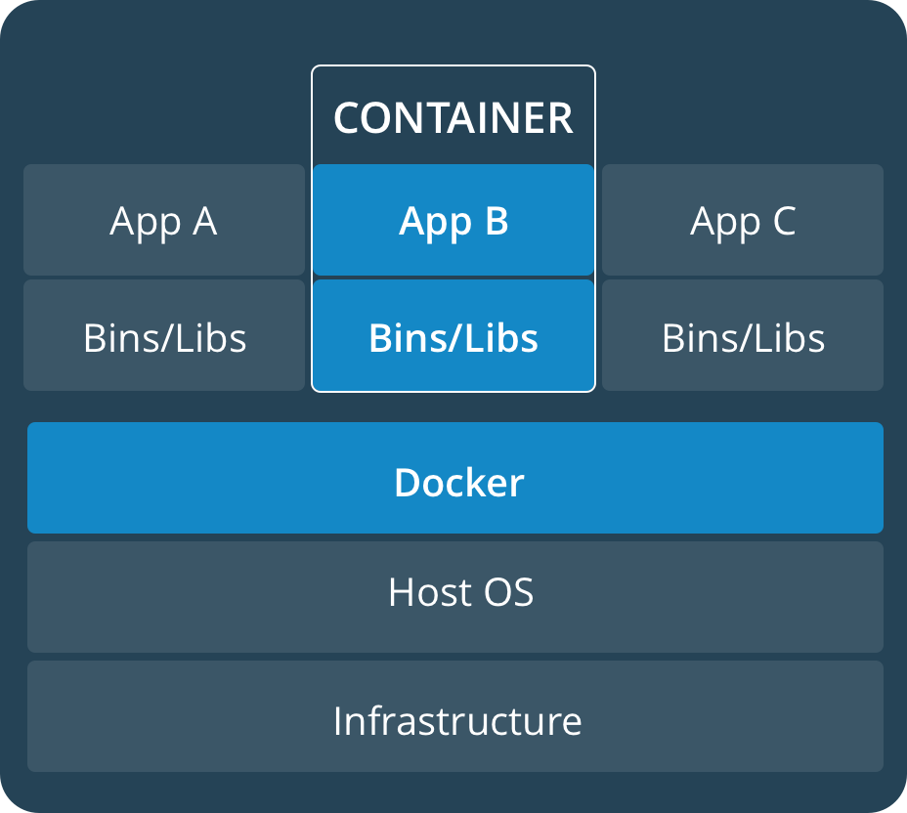
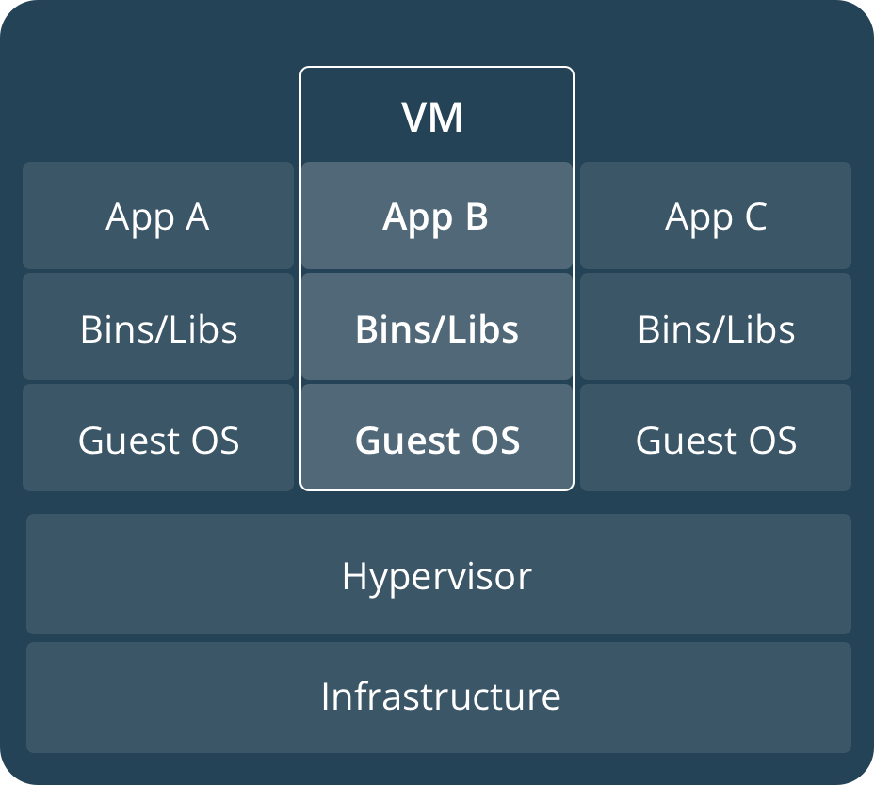
Virtualization vs. Containerization
Containers and VMs have similar resource isolation and allocation benefits
However, containers virtualize the operating system instead of hardware
Containers are more portable and efficient; let’s have a look:
Notes:
Comparing Containers and Virtual Machines
Containers and virtual machines have similar resource isolation and allocation benefits, but...
function differently because containers virtualize the operating system instead of hardware.
Containers are more portable and efficient.
CONTAINERS
Containers are an abstraction at the app layer that packages code and dependencies together. Multiple containers can run on the same machine and share the OS kernel with other containers, each running as isolated processes in user space. Containers take up less space than VMs (container images are typically tens of MBs in size), and start almost instantly.
VIRTUAL MACHINES
Virtual machines (VMs) are an abstraction of physical hardware turning one server into many servers. The hypervisor allows multiple VMs to run on a single machine. Each VM includes a full copy of an operating system, one or more apps, necessary binaries and libraries - taking up tens of GBs. VMs can also be slow to boot.

Slide 14
Containerization
Containers are an abstraction at the app layer
Multiple containers can run on the same machine and share the OS kernel
Each running as isolated processes in user space
Containers take up less space than VMs and start almost instantly
Notes:
CONTAINERS
Containers are an abstraction at the app layer that packages code and dependencies together.
Multiple containers can run on the same machine and share the OS kernel with other containers,
each running as isolated processes in user space.
Containers take up less space than VMs (container images are typically tens of MBs in size), and start almost instantly.

Slide 15
Virtualization
VMs are an abstraction of physical hardware
The hypervisor allows multiple VMs to run on a single machine
Each VM includes a full copy of an operating system, one or more apps, necessary binaries and libraries
VMs can also be slow to boot.
Notes:
VIRTUAL MACHINES
Virtual machines (VMs) are an abstraction of physical hardware turning one server into many servers.
The hypervisor allows multiple VMs to run on a single machine.
Each VM includes a full copy of an operating system, one or more apps, necessary binaries and libraries...
taking up tens of GBs.
VMs can also be slow to boot.

Slide 16
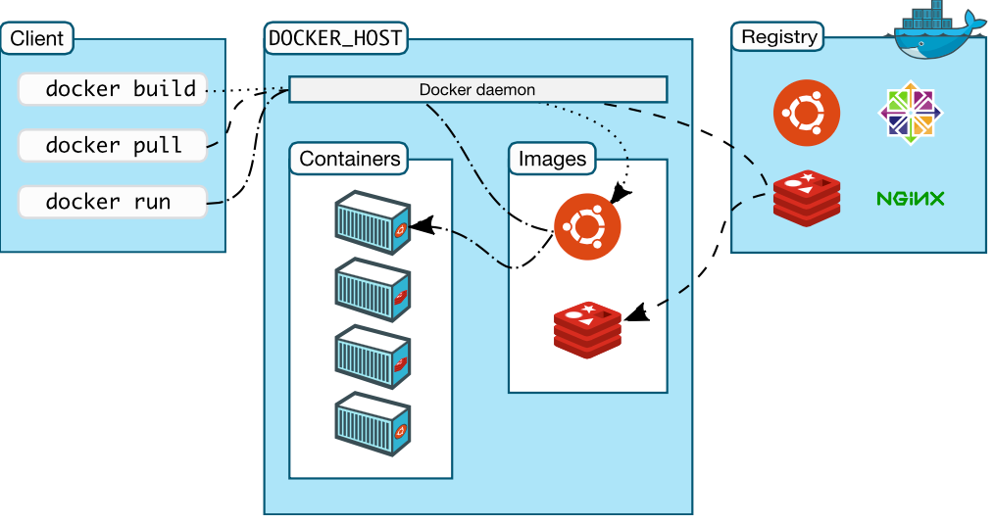
Docker Architecture
Notes:
Docker architecture
SHARE:
Docker uses a client-server architecture.
The Docker client talks to the Docker daemon, which does the heavy lifting of building, running, and distributing your Docker containers.
The Docker client and daemon can run on the same system, or you can connect a Docker client to a remote Docker daemon.
The Docker client and daemon communicate using a REST API, over UNIX sockets or a network interface.

Slide 17
Architecture Components
The Docker daemon (dockerd) listens for Docker API requests and manages Docker objects such as images, containers, networks, and volumes
The Docker client (docker) is the primary way that many Docker users interact with Docker
A Docker registry stores Docker images
Docker store allows you to buy and sell Docker images or distribute them
Notes:
The Docker daemon
The Docker daemon (dockerd) listens for Docker API requests and manages Docker objects such as images, containers, networks, and volumes.
SHARE:
A daemon can also communicate with other daemons to manage Docker services.
The Docker client
The Docker client (docker) is the primary way that many Docker users interact with Docker.
SHARE:
When you use commands such as docker run, the client sends these commands to dockerd, which carries them out. The docker command uses the Docker API. The Docker client can communicate with more than one daemon.
Docker registries
A Docker registry stores Docker images.
SHARE:
Docker Hub and Docker Cloud are public registries that anyone can use, and Docker is configured to look for images on Docker Hub by default. You can even run your own private registry. If you use Docker Datacenter (DDC), it includes Docker Trusted Registry (DTR).
When you use the docker pull or docker run commands, the required images are pulled from your configured registry. When you use the docker push command, your image is pushed to your configured registry.
Docker store allows you to buy and sell Docker images or distribute them for free.
SHARE:
For instance, you can buy a Docker image containing an application or service from a software vendor and use the image to deploy the application into your testing, staging, and production environments. You can upgrade the application by pulling the new version of the image and redeploying the containers.

Slide 18
Docker Objects
When you use Docker, you are creating and using images, containers, networks, volumes, plugins, and other objects
IMAGES:
An image is a read-only template with instructions for creating a Docker container
CONTAINERS:
A container is a runnable instance of an image
SERVICES:
Services allow you to scale containers across multiple Docker daemons, which all work together as a swarm with multiple managers and workers
Notes:
Docker objects
When you use Docker, you are creating and using images, containers, networks, volumes, plugins, and other objects.
This section is a brief overview of some of those objects.
IMAGES
An image is a read-only template with instructions for creating a Docker container.
SHARE:
Often, an image is based on another image, with some additional customization. For example, you may build an image which is based on the ubuntu image, but installs the Apache web server and your application, as well as the configuration details needed to make your application run.
You might create your own images or you might only use those created by others and published in a registry. To build your own image, you create a Dockerfile with a simple syntax for defining the steps needed to create the image and run it. Each instruction in a Dockerfile creates a layer in the image. When you change the Dockerfile and rebuild the image, only those layers which have changed are rebuilt. This is part of what makes images so lightweight, small, and fast, when compared to other virtualization technologies.
CONTAINERS
A container is a runnable instance of an image.
SHARE:
You can create, start, stop, move, or delete a container using the Docker API or CLI. You can connect a container to one or more networks, attach storage to it, or even create a new image based on its current state.
By default, a container is relatively well isolated from other containers and its host machine. You can control how isolated a container’s network, storage, or other underlying subsystems are from other containers or from the host machine.
A container is defined by its image as well as any configuration options you provide to it when you create or start it. When a container is removed, any changes to its state that are not stored in persistent storage disappear.
SERVICES
Services allow you to scale containers across multiple Docker daemons, which all work together as a swarm with multiple managers and workers.
SHARE:
Each member of a swarm is a Docker daemon, and the daemons all communicate using the Docker API. A service allows you to define the desired state, such as the number of replicas of the service that must be available at any given time. By default, the service is load-balanced across all worker nodes. To the consumer, the Docker service appears to be a single application. Docker Engine supports swarm mode in Docker 1.12 and higher.
EXTRA - note shared:
Example docker run command
The following command runs an ubuntu container, attaches interactively to your local command-line session, and runs /bin/bash.
$ docker run -i -t ubuntu /bin/bash
When you run this command, the following happens (assuming you are using the default registry configuration):
1. If you do not have the ubuntu image locally, Docker pulls it from your configured registry, as though you had run docker pull ubuntu manually.
2. Docker creates a new container, as though you had run a docker container create command manually.
3. Docker allocates a read-write filesystem to the container, as its final layer. This allows a running container to create or modify files and directories in its local filesystem.
4. Docker creates a network interface to connect the container to the default network, since you did not specify any networking options. This includes assigning an IP address to the container. By default, containers can connect to external networks using the host machine’s network connection.
5. Docker starts the container and executes /bin/bash. Because the container is run interactively and attached to your terminal (due to the -i and -t) flags, you can provide input using your keyboard and output is logged to your terminal.
6. When you type exit to terminate the /bin/bash command, the container stops but is not removed. You can start it again or remove it.

Slide 19
History of Docker
Linux containers, the technology upon which Docker’s software was originally built, were introduced in 2008.
Docker was released as an open source project by dotCloud, a platform as a service company, in 2013.
One month after launching an interactive tutorial in August 2013, Docker said 10,000 developers tried it out.
When Docker announced its 1.0 release in June 2014, the Docker Engine software had already been downloaded 2.75 million times.
That number now stands at more than 100 million.
Powered by Virtuant © 2016

Slide 20
Docker Evolutionary Timeline
1979: Unix V7
2000: FreeBSD Jails
2001: Linux Vserver
2004: Oracle Solaris Containers
2005: Open VZ (Open Virtuzzo)
2006: Process Containers
2008: LXC
2011: Warden
2013: LMCTFY
2013: Docker and the Future
Notes:
Docker Evolutionary Timeline:
1979: Unix V7
SHARE:
During the development of Unix V7 in 1979, the chroot system call was introduced, changing the root directory of a process and its children to a new location in the filesystem. This advance was the beginning process isolation: segregating file access for each process. Chroot was added to BSD in 1982.
2000: FreeBSD Jails
SHARE:
Flash-forward nearly two decades later to 2000, when a small shared-environment hosting provider came up with FreeBSD jails to achieve clear-cut separation between its services and those of its customers for security and ease of administration. FreeBSD Jails allows administrators to partition a FreeBSD computer system into several independent, smaller systems – called “jails” – with the ability to assign an IP address for each system and configuration.
2001: Linux Vserver
SHARE:
Like FreeBSD Jails, Linux VServer is a jail mechanism that can partitionresources (file systems, network addresses, memory) on a computer system. Introduced in 2001, this operating system virtualization that is implemented by patching the Linux kernel. Experimental patches are still available, but the last stable patch was released in 2006
2004: Oracle Solaris Containers
SHARE:
2004 Oracle released a Solaris Container that combines system resource controls and boundary separation provided by zones, which were able to leverage features like snapshots and cloning from ZFS.
2005: Open VZ (Open Virtuzzo)
SHARE:
This is an operating system-level virtualization technology for Linu x which uses a patched Linux kernel for virtualization, isolation, resource management and checkpointing. The code was not released as part of the official Linux kernel.
2006: Process Containers
SHARE:
Process Containers (launched by Google in 2006) was designed for limiting, accounting and isolating resource usage (CPU, memory, disk I/O, network) of a collection of processes. It was renamed “Control Groups (cgroups)” a year later and eventually merged to Linux kernel 2.6.24.
2008: LXC
SHARE:
LXC (LinuX Containers) was the first, most complete implementation of Linux container manager. It was implemented in 2008 using cgroups and Linux namespaces, and it works on a single Linux kernel without requiring any patches.
2011: Warden
SHARE:
CloudFoundry started Warden in 2011, using LXC in the early stages and later replacing it with its own implementation. Warden can isolate environments on any operating system, running as a daemon and providing an API for container management. It developed a client-server model to manage a collection of containers across multiple hosts, and Warden includes a service to manage cgroups, namespaces and the process life cycle.
2013: LMCTFY
SHARE:
Let Me Contain That For You (LMCTFY) kicked off in 2013 as an open-source version of Google's container stack, providing Linux application containers. Applications can be made “container aware,” creating and managing their own subcontainers. Active deployment in LMCTFY stopped in 2015 after Google started contributing core LMCTFY concepts to libcontainer, which is now part of the Open Container Foundation.
2013: Docker and the Future
SHARE:
That’s my (not so brief) summation of the pre-Docker container landscape. All those iterations had their adopters and devotees, but when Docker emerged in 2013, containers exploded in popularity. It’s no coincidence the growth of Docker and container use goes hand-in-hand.
Just as Warden did, Docker also used LXC in its initial stages and later replaced that container manager with its own library, libcontainer. But I’ve no doubt that Docker separated itself from the pack by offering an entire ecosystem for container management.
With Docker, developers can create and run application containers quickly. And with the release of Docker Hub, developers can download and run application containers even faster.
SHARE:
Within only 3 years, I, like countless others find it difficult to imagine a devops life without the Docker eco-system. I’m loving being a part of of its growth journey and find developing a security product integral to its ecosystem an eye opener on many levels.
Of course, Docker is not alone in this future of containers. In February, CoreOS launched rkt (that’s “rocket” if you want to spell it out) with the intent of becoming a credible alternative to Docker. As InfoWorld succinctly put it: rkt intends to do the same tasks as Docker but do them better when they can.

Slide 21
The Underlying Technology
Docker is written in Go and takes advantage of several features of the Linux kernel to deliver its functionality
NAMESPACES:
Docker uses a technology called namespaces to provide the isolated workspace called the container
When you run a container, Docker creates a set of namespaces for that container
These namespaces provide a layer of isolation
Each aspect of a container runs in a separate namespace and its access is limited to that namespace
Notes:
The underlying technology
Docker is written in Go and takes advantage of several features of the Linux kernel to deliver its functionality.
Namespaces
Docker uses a technology called namespaces to provide the isolated workspace called the container.
When you run a container, Docker creates a set of namespaces for that container.
These namespaces provide a layer of isolation.
Each aspect of a container runs in a separate namespace and its access is limited to that namespace.

Slide 22

Namespaces
Docker Engine uses namespaces such as the following on Linux:
mnt mount points, filesystem
pid processes
net network stack
ipc inter-process comms
uts hostname
user UIDs

Slide 23
Namespaces
Isolating views of the system
You can make a process think it’s the only process
Built-in ways to "virtualize" a process
Wikipedia says:
“Namespaces are a feature of the Linux kernel that isolates and virtualizes system resources of a collection of processes. Examples of resources that can be virtualized include process IDs, hostnames, user IDs, network access, inter-process communication, and filesystems.”
Notes:
Kernel namespaces
SHARE:
Docker containers are very similar to LXC containers, and they have similar security features. When you start a container with docker run, behind the scenes Docker creates a set of namespaces and control groups for the container.
Namespaces provide the first and most straightforward form of isolation: processes running within a container cannot see, and even less affect, processes running in another container, or in the host system.

Slide 24
The Underlying Technology
CGROUPS:
Docker Engine on Linux also relies on another technology called control groups (cgroups)
A cgroup limits an application to a specific set of resources
Control groups allow Docker Engine to share available hardware resources to containers and optionally enforce limits and constraints
For example, you can limit the memory available to a specific container
Notes:
Control groups
Docker Engine on Linux also relies on another technology called control groups (cgroups).
A cgroup limits an application to a specific set of resources.
Control groups allow Docker Engine to share available hardware resources to containers and optionally enforce limits and constraints.
For example, you can limit the memory available to a specific container.

Slide 25
What Are cgroups?
Built into Kernel (RHEL7/Debian/etc)
Generically isolates resource usage (CPU, memory, disk, network)
Guarantee resources to app/set of apps
Can be adjusted on the fly
Can monitor the cgroup itself to see utilization
Wikipedia says:
“cgroups (abbreviated from control groups) is a Linux kernel feature that limits, accounts for, and isolates the resource usage (CPU, memory, disk I/O, network, etc.) of a collection of processes.“
Notes:
Control groups
SHARE:
Control Groups are another key component of Linux Containers.
They implement resource accounting and limiting.
They provide many useful metrics, but they also help ensure that each container gets its fair share of memory, CPU, disk I/O; and, more importantly, that a single container cannot bring the system down by exhausting one of those resources.
So while they do not play a role in preventing one container from accessing or affecting the data and processes of another container, they are essential to fend off some denial-of-service attacks. They are particularly important on multi-tenant platforms, like public and private PaaS, to guarantee a consistent uptime (and performance) even when some applications start to misbehave.
Control Groups have been around for a while as well: the code was started in 2006, and initially merged in kernel 2.6.24.

Slide 26
Diagram of Control Groups
CPU
512 Shares
MEMORY
No Limit
NETWORK
No Limit
STORAGE
I/0
No limit
PROCESSES
Firefox-*, npmviewer.bin
CGROUP No. 1
USERS
@admin, student-1, student-2, guest

Slide 27
The Underlying Technology
UNION FILE SYSTEMS:
Union file systems, or UnionFS, are file systems that operate by creating layers, making them very lightweight and fast
Docker Engine uses UnionFS to provide the building blocks for containers
Docker Engine can use multiple UnionFS variants, including AUFS, btrfs, vfs, and DeviceMapper
UNION FILE SYSTEMS:
Docker Engine combines the namespaces, control groups, and UnionFS into a wrapper called a container format
The default container format is libcontainer
Notes:
Union file systems
Union file systems, or UnionFS, are file systems that operate by creating layers, making them very lightweight and fast.
Docker Engine uses UnionFS to provide the building blocks for containers.
Docker Engine can use multiple UnionFS variants, including AUFS, btrfs, vfs, and DeviceMapper.
Container format
Docker Engine combines the namespaces, control groups, and UnionFS into a wrapper called a container format.
The default container format is libcontainer.
SHARE:
In the future, Docker may support other container formats by integrating with technologies such as BSD Jails or Solaris Zones.

Slide 28
Linux capabilities
Bhavuk, is this slide helpful? Delete?
Like Linux, root has all capabilities.
Includes a fine-grained division of root's permissions for a processes.
CAP_NET_ADMIN - modify routing tables, firewalling, NAT, etc.
CAP_KILL - bypass any checks for sending the kill signals
CAP_SYS_ADMIN - mount, set hostname, etc.
Notes:
Linux kernel capabilities
By default, Docker starts containers with a restricted set of capabilities. What does that mean?
Capabilities turn the binary “root/non-root” dichotomy into a fine-grained access control system. Processes (like web servers) that just need to bind on a port below 1024 do not have to run as root: they can just be granted the net_bind_service capability instead. And there are many other capabilities, for almost all the specific areas where root privileges are usually needed.
This means a lot for container security; let’s see why!
Your average server (bare metal or virtual machine) needs to run a bunch of processes as root. Those typically include SSH, cron, syslogd; hardware management tools (e.g., load modules), network configuration tools (e.g., to handle DHCP, WPA, or VPNs), and much more. A container is very different, because almost all of those tasks are handled by the infrastructure around the container:
SSH access will typically be managed by a single server running on the Docker host;
cron, when necessary, should run as a user process, dedicated and tailored for the app that needs its scheduling service, rather than as a platform-wide facility;
log management will also typically be handed to Docker, or by third-party services like Loggly or Splunk;
hardware management is irrelevant, meaning that you never need to run udevd or equivalent daemons within containers;
network management happens outside of the containers, enforcing separation of concerns as much as possible, meaning that a container should never need to perform ifconfig, route, or ip commands (except when a container is specifically engineered to behave like a router or firewall, of course).

Slide 29
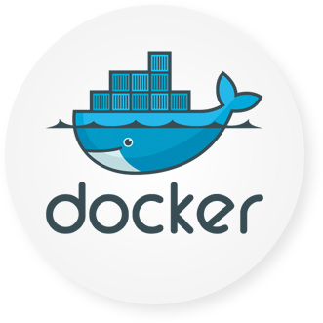
Docker Brings Together
Linux Kernel
Storage
Device Mapper
Btrfs
Aufs
Namespaces
Networking
PID
MNT
IPC
UTS
NET
veth
bridge
iptables
Cgroups
Security
cpu
cpuset
memory
device
Capability
SELinux
seccomp

Slide 30
Why is this Important?
Bhavuk, is this slide helpful? Delete?
Think about image formatting vs. golden imaging
What about when using API calls?
Or, packaging...
Structural separation of concerns (Devs/Ops)
Density and infrastructure utilization

Slide 31
What can I use Docker for?
Fast, consistent delivery of your applications
Docker streamlines the development lifecycle by allowing developers to work in standardized environments using local containers which provide your applications and services
Containers are great for continuous integration and continuous delivery (CI/CD) workflows
Responsive deployment and scaling
Docker’s container-based platform allows for highly portable workloads
Docker containers can run on a developer’s local laptop, on physical or virtual machines in a data center, on cloud providers, or in a mixture of environments
Notes:
What can I use Docker for?
Fast, consistent delivery of your applications
Docker streamlines the development lifecycle by allowing developers to work in standardized environments using local containers which provide your applications and services.
Containers are great for continuous integration and continuous delivery (CI/CD) workflows.
SHARE:
Consider the following example scenario:
Your developers write code locally and share their work with their colleagues using Docker containers.
They use Docker to push their applications into a test environment and execute automated and manual tests.
When developers find bugs, they can fix them in the development environment and redeploy them to the test environment for testing and validation.
When testing is complete, getting the fix to the customer is as simple as pushing the updated image to the production environment.
Responsive deployment and scaling
Docker’s container-based platform allows for highly portable workloads.
Docker containers can run on a developer’s local laptop, on physical or virtual machines in a data center, on cloud providers, or in a mixture of environments.
SHARE:
Docker’s portability and lightweight nature also make it easy to dynamically manage workloads, scaling up or tearing down applications and services as business needs dictate, in near real time.

Slide 32
What can I use Docker for?
Running more workloads on the same hardware
Docker is lightweight and fast
It provides a viable, cost-effective alternative to hypervisor-based virtual machines, so you can use more of your compute capacity to achieve your business goals
Docker is perfect for high density environments and for small and medium deployments where you need to do more with fewer resources
Notes:
Running more workloads on the same hardware
Docker is lightweight and fast.
It provides a viable, cost-effective alternative to hypervisor-based virtual machines, so you can use more of your compute capacity to achieve your business goals.
Docker is perfect for high density environments and for small and medium deployments where you need to do more with fewer resources.

Slide 33
Basic Terms To Know
Container - a live running instance of a Docker image
Image - a saved state of a container
Docker Hub - like Github, it is where you will ‘push’ and ‘pull’ images from
Tag - a kind of label or version control pinned to an image to distinguish from other images on host and hub
Dockerfile - compiled code used to build a image from specifications
Powered by Virtuant © 2016
Notes:
container
A container is a runtime instance of a docker image.
A Docker container consists of
-A Docker image
-Execution environment
-A standard set of instructions
The concept is borrowed from Shipping Containers, which define a standard to ship goods globally. Docker defines a standard to ship software.
image
Docker images are the basis of containers. An Image is an ordered collection of root filesystem changes and the corresponding execution parameters for use within a container runtime. An image typically contains a union of layered filesystems stacked on top of each other. An image does not have state and it never changes.
tag
A tag is a label applied to a Docker image in a repository. tags are how various images in a repository are distinguished from each other.
Note : This label is not related to the key=value labels set for docker daemon
aufs
aufs (advanced multi layered unification filesystem) is a Linux filesystem that Docker supports as a storage backend. It implements the union mount for Linux file systems.
base image
An image that has no parent is a base image.
boot2docker
boot2docker is a lightweight Linux distribution made specifically to run Docker containers. The boot2docker management tool for Mac and Windows was deprecated and replaced by docker-machine which you can install with the Docker Toolbox.
btrfs
btrfs (B-tree file system) is a Linux filesystem that Docker supports as a storage backend. It is a copy-on-write filesystem.
build
build is the process of building Docker images using a Dockerfile. The build uses a Dockerfile and a “context”. The context is the set of files in the directory in which the image is built.
cgroups
cgroups is a Linux kernel feature that limits, accounts for, and isolates the resource usage (CPU, memory, disk I/O, network, etc.) of a collection of processes. Docker relies on cgroups to control and isolate resource limits.
Also known as : control groups
Compose
Compose is a tool for defining and running complex applications with Docker. With compose, you define a multi-container application in a single file, then spin your application up in a single command which does everything that needs to be done to get it running.
Also known as : docker-compose, fig
container
A container is a runtime instance of a docker image.
A Docker container consists of
A Docker image
Execution environment
A standard set of instructions
The concept is borrowed from Shipping Containers, which define a standard to ship goods globally. Docker defines a standard to ship software.
data volume
A data volume is a specially-designated directory within one or more containers that bypasses the Union File System. Data volumes are designed to persist data, independent of the container’s life cycle. Docker therefore never automatically delete volumes when you remove a container, nor will it “garbage collect” volumes that are no longer referenced by a container.
Docker
The term Docker can refer to
The Docker project as a whole, which is a platform for developers and sysadmins to develop, ship, and run applications
The docker daemon process running on the host which manages images and containers
Docker Hub
The Docker Hub is a centralized resource for working with Docker and its components. It provides the following services:
Docker image hosting
User authentication
Automated image builds and work-flow tools such as build triggers and web hooks
Integration with GitHub and Bitbucket
Dockerfile
A Dockerfile is a text document that contains all the commands you would normally execute manually in order to build a Docker image. Docker can build images automatically by reading the instructions from a Dockerfile.
filesystem
A file system is the method an operating system uses to name files and assign them locations for efficient storage and retrieval.
Examples :
Linux : ext4, aufs, btrfs, zfs
Windows : NTFS
macOS : HFS+
image
Docker images are the basis of containers. An Image is an ordered collection of root filesystem changes and the corresponding execution parameters for use within a container runtime. An image typically contains a union of layered filesystems stacked on top of each other. An image does not have state and it never changes.
libcontainer
libcontainer provides a native Go implementation for creating containers with namespaces, cgroups, capabilities, and filesystem access controls. It allows you to manage the lifecycle of the container performing additional operations after the container is created.
libnetwork
libnetwork provides a native Go implementation for creating and managing container network namespaces and other network resources. It manage the networking lifecycle of the container performing additional operations after the container is created.
link
links provide a legacy interface to connect Docker containers running on the same host to each other without exposing the hosts’ network ports. Use the Docker networks feature instead.
Machine
Machine is a Docker tool which makes it really easy to create Docker hosts on your computer, on cloud providers and inside your own data center. It creates servers, installs Docker on them, then configures the Docker client to talk to them.
Also known as : docker-machine
node
A node is a physical or virtual machine running an instance of the Docker Engine in swarm mode.
Manager nodes perform swarm management and orchestration duties. By default manager nodes are also worker nodes.
Worker nodes execute tasks.
overlay network driver
Overlay network driver provides out of the box multi-host network connectivity for docker containers in a cluster.
overlay storage driver
OverlayFS is a filesystem service for Linux which implements a union mount for other file systems. It is supported by the Docker daemon as a storage driver.
registry
A Registry is a hosted service containing repositories of images which responds to the Registry API.
The default registry can be accessed using a browser at Docker Hub or using the docker search command.
repository
A repository is a set of Docker images. A repository can be shared by pushing it to a registry server. The different images in the repository can be labeled using tags.
Here is an example of the shared nginx repository and its tags
service
A service is the definition of how you want to run your application containers in a swarm. At the most basic level a service defines which container image to run in the swarm and which commands to run in the container. For orchestration purposes, the service defines the “desired state”, meaning how many containers to run as tasks and constraints for deploying the containers.
Frequently a service is a microservice within the context of some larger application. Examples of services might include an HTTP server, a database, or any other type of executable program that you wish to run in a distributed environment.
service discovery
Swarm mode service discovery is a DNS component internal to the swarm that automatically assigns each service on an overlay network in the swarm a VIP and DNS entry. Containers on the network share DNS mappings for the service via gossip so any container on the network can access the service via its service name.
You don’t need to expose service-specific ports to make the service available to other services on the same overlay network. The swarm’s internal load balancer automatically distributes requests to the service VIP among the active tasks.
swarm
A swarm is a cluster of one or more Docker Engines running in swarm mode.
Swarm
Do not confuse Docker Swarm with the swarm mode features in Docker Engine.
Docker Swarm is the name of a standalone native clustering tool for Docker. Docker Swarm pools together several Docker hosts and exposes them as a single virtual Docker host. It serves the standard Docker API, so any tool that already works with Docker can now transparently scale up to multiple hosts.
Also known as : docker-swarm
swarm mode
Swarm mode refers to cluster management and orchestration features embedded in Docker Engine. When you initialize a new swarm (cluster) or join nodes to a swarm, the Docker Engine runs in swarm mode.
tag
A tag is a label applied to a Docker image in a repository. tags are how various images in a repository are distinguished from each other.
Note : This label is not related to the key=value labels set for docker daemon
task
A task is the atomic unit of scheduling within a swarm. A task carries a Docker container and the commands to run inside the container. Manager nodes assign tasks to worker nodes according to the number of replicas set in the service scale.
The diagram below illustrates the relationship of services to tasks and containers.
services diagram
Toolbox
Docker Toolbox is the installer for Mac and Windows users.
Union file system
Union file systems, or UnionFS, are file systems that operate by creating layers, making them very lightweight and fast. Docker uses union file systems to provide the building blocks for containers.
virtual machine
A virtual machine is a program that emulates a complete computer and imitates dedicated hardware. It shares physical hardware resources with other users but isolates the operating system. The end user has the same experience on a Virtual Machine as they would have on dedicated hardware.
Compared to containers, a virtual machine is heavier to run, provides more isolation, gets its own set of resources and does minimal sharing.

Slide 34
Containers in Software Delivery Pipeline

Slide 35
Containers in Software Delivery Pipeline
What is Continuous Integration (CI)?
What is Continuous Delivery (CD)?
Notes:
ccc

Slide 36
Developer Workflow
Work from Vagrant image
Can trash and reboot it any time
Locally running Docker client
Source code in developer IDE
When ready, use tooling to generate Docker image, or hand craft
Run image locally - possibly with others
Push code, or image
CI process kicks in

Slide 37
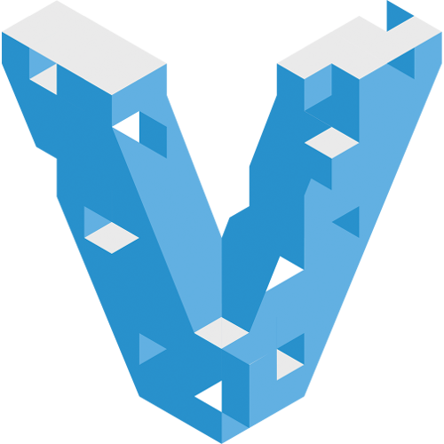


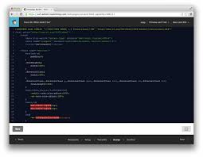
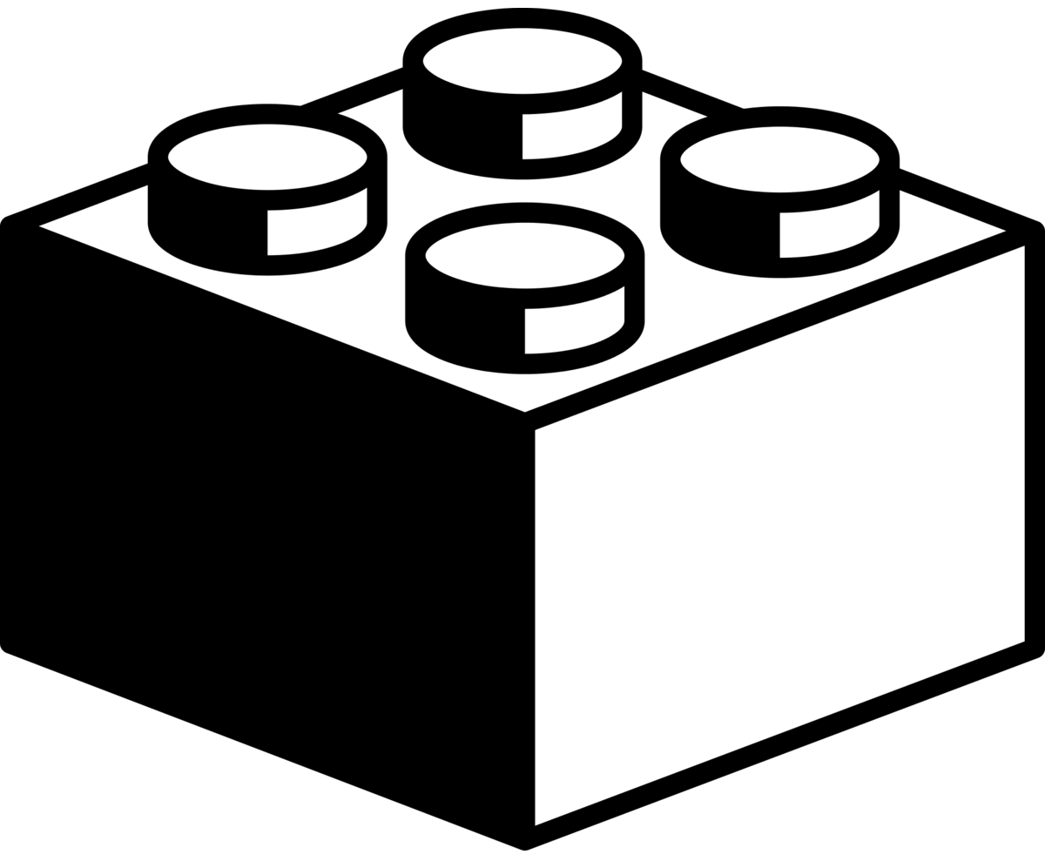
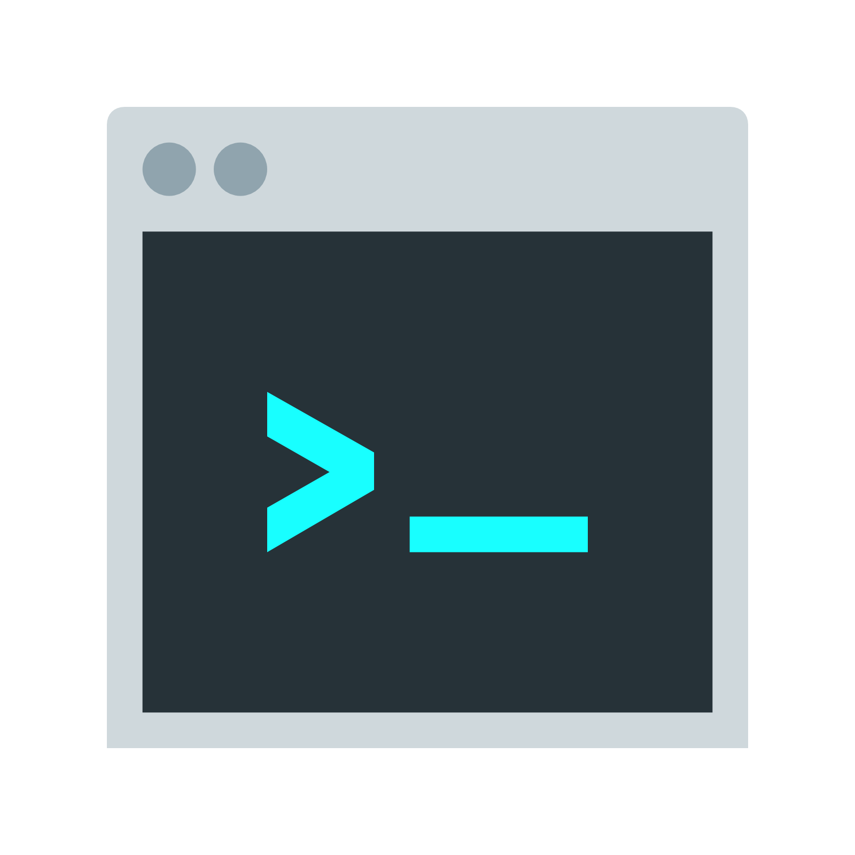
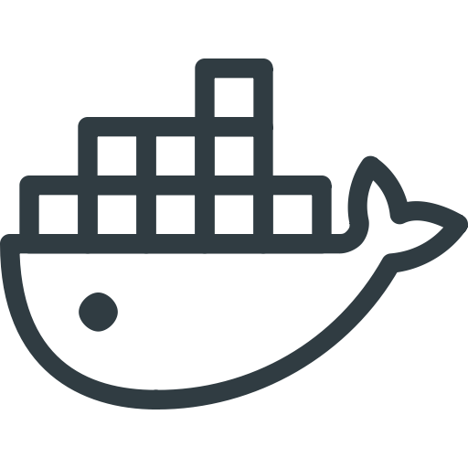
Developer Works Locally
Image
Development
Client
BUILD
Dockerfile

Slide 38
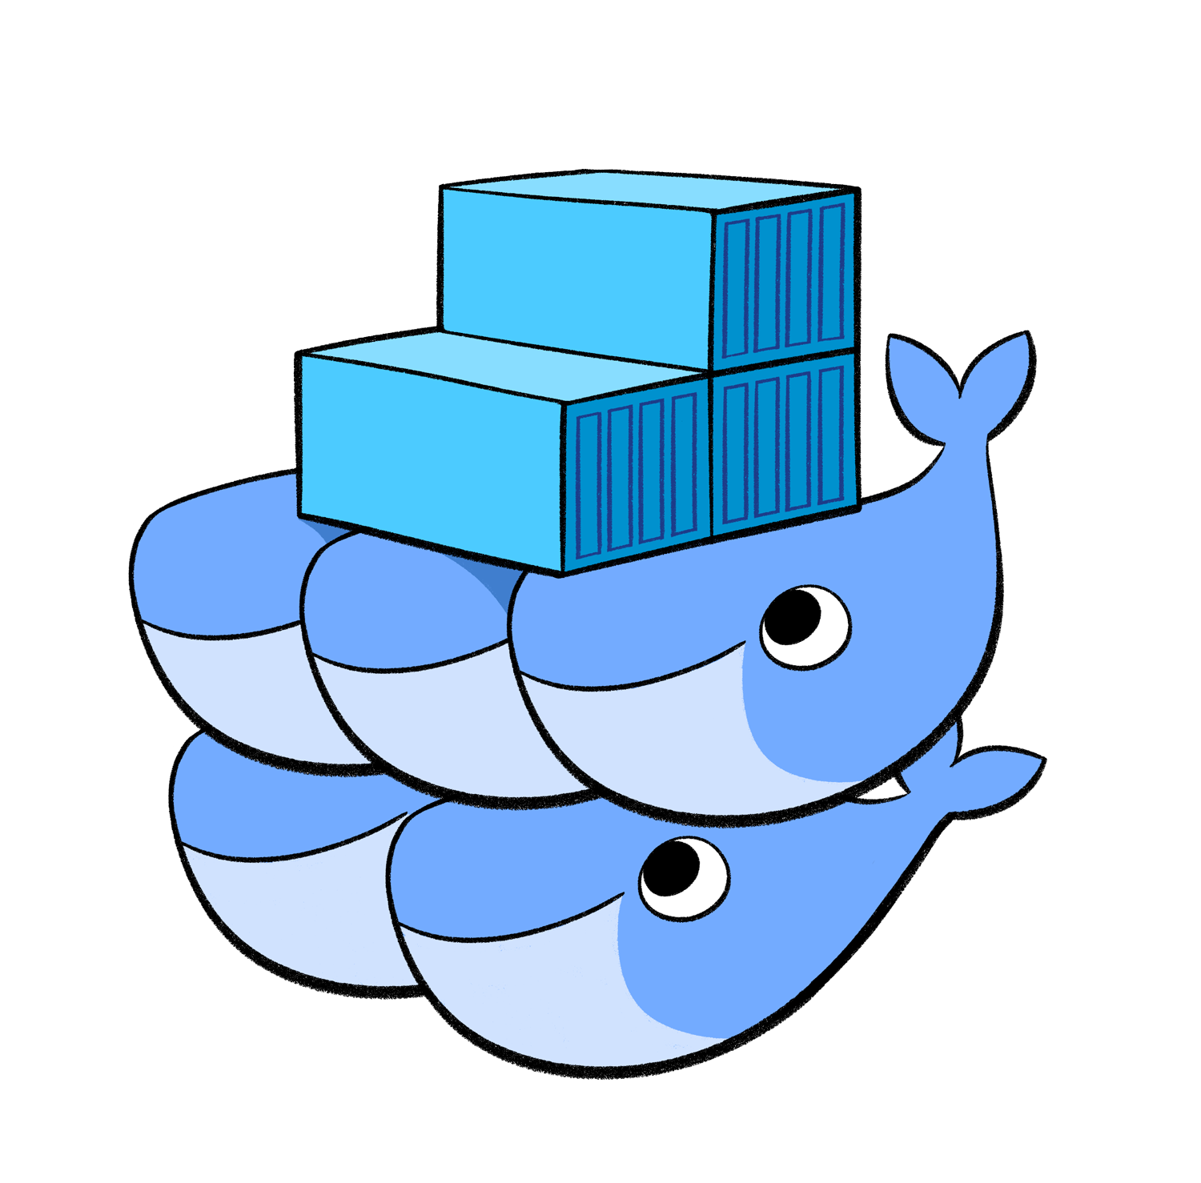


Developer Pushes Code
Development
Image
Client
BUILD
Dockerfile
Image
BUILD
Dockerfile

Slide 39
Challenges with Monolithic Applications

Slide 40
Challenges with Monolithic Applications
Template
$ template
xx.xxx.xx.x

Slide 41
What is Container Orchestration?

Slide 42
What is Container Orchestration?
Template
xx.xxx.xx.x

Slide 43
Container Management Solutions

Slide 44
Container Management Solutions
Template
$ template
xx.xxx.xx.x
Notes:
Integrated Container Management
Docker Datacenter is now a part of Docker EE - providing integrated container management and security from development to production. Enterprise-ready capabilities like multi-architecture orchestration, secure software supply chain, and infrastructure independence give IT teams the ability to manage and secure containers without breaking the developer experience. Open interfaces allow for easy integration into existing systems and the flexibility to support any range of business processes. Docker EE is more than just a container orchestration solution; it is a full lifecycle management solution for the modernization of traditional applications and microservices across a broad set of infrastructure platforms.
Integrated management of all app resources from a single web admin UI.
Frictionlessly deploy apps and Compose files to production in a few clicks.
Multi-tenant system with granular Role Based Access Control (RBAC) and LDAP/AD integration.
Self-healing application deployments with the ability to apply rolling application updates.
End to end security model with secrets management, image signing and image security scanning.
Open and extensible to existing enterprise systems and processes.

Slide 45
Introduction to Lab Environment

Slide 46
Introduction to Lab Environment
Let’s talk about our lab environment!

Slide 47
End of Chapter

Slide 48
START - slides from other classes

Slide 49
What is This Docker Thing?
A company?
A format?
An API?
Framework?
Or, maybe something in the Cloud!
Notes:
Overview
Docker is the world’s leading software container platform. Developers use Docker to eliminate “works on my machine” problems when collaborating on code with co-workers. Operators use Docker to run and manage apps side-by-side in isolated containers to get better compute density. Enterprises use Docker to build agile software delivery pipelines to ship new features faster, more securely and with confidence for both Linux and Windows Server apps.

Slide 50
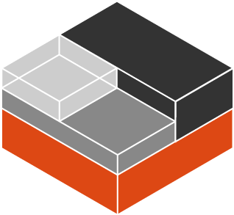
That’s Not New About Docker
Linux-native functionality
Control Groups (cgroups)
Kernel Namespaces
chroot
Linux Capabilities
Security (SELinux)

Slide 51
What Are Cgroups
Built into Kernel (RHEL7/Debian/etc)
Generically isolates resource usage (CPU, memory, disk, network)
Guarantee resources to app/set of apps
Can be adjusted on the fly
Can monitor the cgroup itself to see utilization
Notes:
Control groups
Control Groups are another key component of Linux Containers. They implement resource accounting and limiting. They provide many useful metrics, but they also help ensure that each container gets its fair share of memory, CPU, disk I/O; and, more importantly, that a single container cannot bring the system down by exhausting one of those resources.
So while they do not play a role in preventing one container from accessing or affecting the data and processes of another container, they are essential to fend off some denial-of-service attacks. They are particularly important on multi-tenant platforms, like public and private PaaS, to guarantee a consistent uptime (and performance) even when some applications start to misbehave.
Control Groups have been around for a while as well: the code was started in 2006, and initially merged in kernel 2.6.24.

Slide 52
What Are Cgroups
Wikipedia says:
“cgroups (abbreviated from control groups) is a Linux kernel feature that limits, accounts for, and isolates the resource usage (CPU, memory, disk I/O, network, etc.) of a collection of processes.“

Slide 53
Diagram of Control Groups
CPU
512 Shares
MEMORY
No Limit
NETWORK
No Limit
STORAGE
I/0
No limit
PROCESSES
Firefox-*, npmviewer.bin
CGROUP No. 1
USERS
@admin, student-1, student-2, guest

Slide 54
Kernel Namespaces
Isolating views of the system
You can make a process think it’s the only process
Built-in ways to "virtualize" a process
Wikipedia says:
“Namespaces are a feature of the Linux kernel that isolates and virtualizes system resources of a collection of processes. Examples of resources that can be virtualized include process IDs, hostnames, user IDs, network access, inter-process communication, and filesystems.”
Notes:
Kernel namespaces
Docker containers are very similar to LXC containers, and they have similar security features. When you start a container with docker run, behind the scenes Docker creates a set of namespaces and control groups for the container.
Namespaces provide the first and most straightforward form of isolation: processes running within a container cannot see, and even less affect, processes running in another container, or in the host system.

Slide 55
Kernel Namespaces
mnt mount points, filesystem
pid processes
net network stack
ipc inter-process comms
uts hostname
user UIDs

Slide 56
Linux capabilities
Like Linux, root has all capabilities.
Includes a fine-grained division of root's permissions for a processes.
CAP_NET_ADMIN - modify routing tables, firewalling, NAT, etc.
CAP_KILL - bypass any checks for sending the kill signals
CAP_SYS_ADMIN - mount, set hostname, etc.
Notes:
Linux kernel capabilities
By default, Docker starts containers with a restricted set of capabilities. What does that mean?
Capabilities turn the binary “root/non-root” dichotomy into a fine-grained access control system. Processes (like web servers) that just need to bind on a port below 1024 do not have to run as root: they can just be granted the net_bind_service capability instead. And there are many other capabilities, for almost all the specific areas where root privileges are usually needed.
This means a lot for container security; let’s see why!
Your average server (bare metal or virtual machine) needs to run a bunch of processes as root. Those typically include SSH, cron, syslogd; hardware management tools (e.g., load modules), network configuration tools (e.g., to handle DHCP, WPA, or VPNs), and much more. A container is very different, because almost all of those tasks are handled by the infrastructure around the container:
SSH access will typically be managed by a single server running on the Docker host;
cron, when necessary, should run as a user process, dedicated and tailored for the app that needs its scheduling service, rather than as a platform-wide facility;
log management will also typically be handed to Docker, or by third-party services like Loggly or Splunk;
hardware management is irrelevant, meaning that you never need to run udevd or equivalent daemons within containers;
network management happens outside of the containers, enforcing separation of concerns as much as possible, meaning that a container should never need to perform ifconfig, route, or ip commands (except when a container is specifically engineered to behave like a router or firewall, of course).

Slide 57
Docker Brings Together
Linux Kernel
Storage
Device Mapper
Btrfs
Aufs
Namespaces
Networking
PID
MNT
IPC
UTS
NET
veth
bridge
iptables
Cgroups
Security
cpu
cpuset
memory
device
Capability
SELinux
seccomp

Slide 58
Why is this Important?
Think about image formatting vs. golden imaging
When using API calls
Packaging
Structural separation of concerns (Devs/Ops)
Density and infrastructure utilization

Slide 59
Foundations of Docker
Writable Container
Apache
References
Parent
Image
Image
EMACS
Image
Debian
Base Image
Kernel
bootfs

Slide 60
Foundations of Docker
Writable Container
Apache
References
Parent
Image
Image
EMACS
Image
Debian
Base Image
Kernel
bootfs
Notes:
SHARE:
Here’s a look at the foundations of a Docker Image; which we’ll break down in-depth later on in this course.

Slide 61
Virtualization vs. Containerization
Virtualization
Containerization
app
lib
OS
app
lib
OS
app
lib
app
lib
namespaces
cgroups
chroots
Hypervisor
OS
OS
x86 Hardware
x86 Hardware
Notes:
Containers provide isolated runtime environments for applications: the entire user space environment is exclusively presented to the container, and any changes to it do not impact other containers’ environments. To provide this isolation, a combination of OS-based mechanisms is used: Linux name spaces are used for isolation and scoping mechanism. File system mounts define what files are accessible to the container. cgroups define resource consumption of containers. Still all containers share the same OS kernel which can realize memory footprint efficiencies when identical libraries are used by multiple containers.
With system virtualization, the hypervisor provides a full virtual machine to a guest: the entire OS image including the kernel is now dedicated to the virtual machine. CPU virtualization is used to provide each guest with an exclusive view of a full system environment, and these mechanisms also ensure isolation from other guests. Hypervisor-based management of virtual CPUs, memory and I/O devices is used to define resource consumption of guests.

Slide 62
Immutable Infrastructure
"We’ll put it back in Ansible"
Cattle vs. Pets
Don’t change it; replace it
System created fully from automation; avoid drift
Manual intervention is error prone
How does Docker help?
Notes:
Except a very few like Google that runs containers since almost 10 years, we used to/are using a server or a VM to host our web applications. Simply ask (if it’s not you) the “system” or “devops” team to install and configure whatever it is needed to run that replaces with the language you like web application. Once they finished, we can now updates the source code deployed on the server by using Capistrano or any other deployment tool. The result is that the code is updated on the web server(s).
https://www.slideshare.net/jpetazzo/immutable-infrastructure-with-docker-and-containers-gluecon-2015

Slide 63
Basic Docker Components
Docker Client
Docker Daemon
Images
Registry
Containers
Notes:
The Docker daemon can listen for Docker Remote API requests via three different types of Socket: unix, tcp, and fd.
By default, a unix domain socket (or IPC socket) is created at /var/run/docker.sock, requiring either root permission, or docker group membership.
If you need to access the Docker daemon remotely, you need to enable the tcp Socket. Beware that the default setup provides un-encrypted and un-authenticated direct access to the Docker daemon - and should be secured either using the built in HTTPS encrypted socket, or by putting a secure web proxy in front of it. You can listen on port 2375 on all network interfaces with -H tcp://0.0.0.0:2375, or on a particular network interface using its IP address: -H tcp://192.168.59.103:2375. It is conventional to use port 2375 for un-encrypted, and port 2376 for encrypted communication with the daemon.

Slide 64
Basic Docker Components

Slide 65
Docker Images
Templates from which containers are created
Layered using union filesystems
Each change to the system is a layer added
Typically created from instructions stored in Dockerfiles
Stored in a Docker registry, locally or remotely

Slide 66
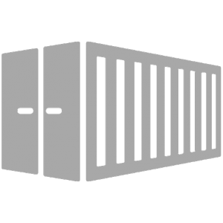
Docker Containers
Runtime instance of a Docker Image
Copy on write file system; changes localized
“Virtualized” with namespaces, cgroups, SELinux, etc.
Each has own IP address, networking, and volumes
Intended to run single process (process virtualization)
Notes:
Because your container is self-sufficient, you will just have to run the container without caring about anything else like mounting volumes, etc…
That means you can share your application with your users or partners in a more easy way. A good example is the Blackfire company that shares their agent in an image that you just have todocker run.

Slide 67
END - slides from other classes

Slide 68
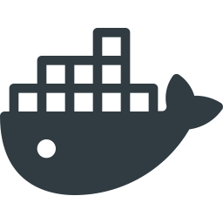
The Docker Way
Now, you can deploy applications using a platform like we just saw, but that’s not the Docker way
The Docker way is to package up your app as a new layer on top of the app server Docker image
Have we talked about a way to package all our components together?
We have...
Build
Run
Docker Image
Dockerfile
Container

Slide 69
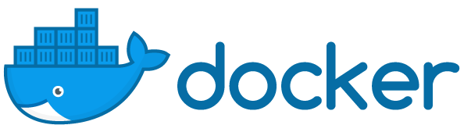
Containers, whales, and more

Slide 70
What is Docker?
Googles says:
“Docker is an open-source project that automates the deployment of applications inside software containers.”
Quote from Docker:
“Docker provides an additional layer of abstraction and automation of operating-system-level virtualization on Linux.”
All about
containers!
Powered by Virtuant © 2016

Slide 71
History of Docker
Linux containers, the technology upon which Docker’s software was originally built, were introduced in 2008.
Docker was released as an open source project by dotCloud, a platform as a service company, in 2013.
One month after launching an interactive tutorial in August 2013, Docker said 10,000 developers tried it out.
When Docker announced its 1.0 release in June 2014, the Docker Engine software had already been downloaded 2.75 million times.
That number now stands at more than 100 million.
Powered by Virtuant © 2016

Slide 72
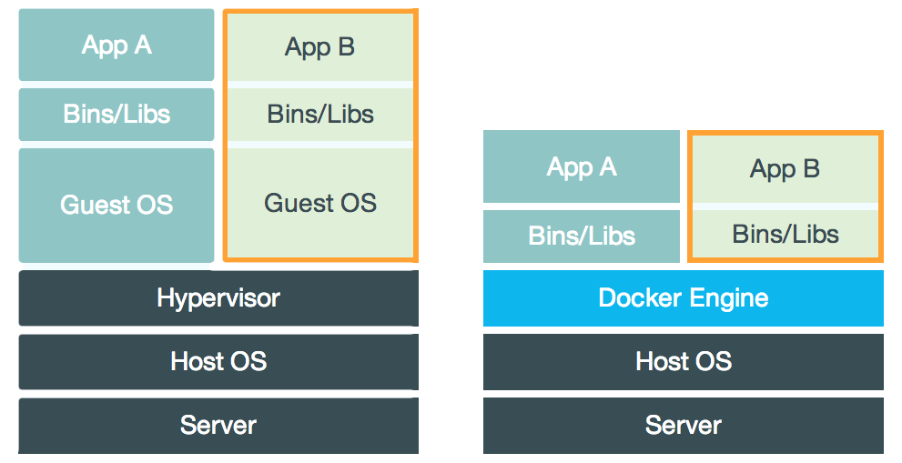
Docker vs. Virtual Machines
Docker is similar, but creates less dependancies
VM
Docker
It does that by using “Docker Engine” rather than a “Guest OS”
Powered by Virtuant © 2016

Slide 73
Foundations of Docker
Writable Container
Apache
References
Parent
Image
Image
EMACS
Image
Debian
Base Image
Kernel
bootfs

Slide 74
Basic Terms To Know
Container - a live running instance of a Docker image
Image - a saved state of a container
Docker Hub - like Github, it is where you will ‘push’ and ‘pull’ images from
Tag - a kind of label or version control pinned to an image to distinguish from other images on host and hub
Dockerfile - compiled code used to build a image from specifications
Powered by Virtuant © 2016
Notes:
container
A container is a runtime instance of a docker image.
A Docker container consists of
-A Docker image
-Execution environment
-A standard set of instructions
The concept is borrowed from Shipping Containers, which define a standard to ship goods globally. Docker defines a standard to ship software.
image
Docker images are the basis of containers. An Image is an ordered collection of root filesystem changes and the corresponding execution parameters for use within a container runtime. An image typically contains a union of layered filesystems stacked on top of each other. An image does not have state and it never changes.
tag
A tag is a label applied to a Docker image in a repository. tags are how various images in a repository are distinguished from each other.
Note : This label is not related to the key=value labels set for docker daemon
aufs
aufs (advanced multi layered unification filesystem) is a Linux filesystem that Docker supports as a storage backend. It implements the union mount for Linux file systems.
base image
An image that has no parent is a base image.
boot2docker
boot2docker is a lightweight Linux distribution made specifically to run Docker containers. The boot2docker management tool for Mac and Windows was deprecated and replaced by docker-machine which you can install with the Docker Toolbox.
btrfs
btrfs (B-tree file system) is a Linux filesystem that Docker supports as a storage backend. It is a copy-on-write filesystem.
build
build is the process of building Docker images using a Dockerfile. The build uses a Dockerfile and a “context”. The context is the set of files in the directory in which the image is built.
cgroups
cgroups is a Linux kernel feature that limits, accounts for, and isolates the resource usage (CPU, memory, disk I/O, network, etc.) of a collection of processes. Docker relies on cgroups to control and isolate resource limits.
Also known as : control groups
Compose
Compose is a tool for defining and running complex applications with Docker. With compose, you define a multi-container application in a single file, then spin your application up in a single command which does everything that needs to be done to get it running.
Also known as : docker-compose, fig
container
A container is a runtime instance of a docker image.
A Docker container consists of
A Docker image
Execution environment
A standard set of instructions
The concept is borrowed from Shipping Containers, which define a standard to ship goods globally. Docker defines a standard to ship software.
data volume
A data volume is a specially-designated directory within one or more containers that bypasses the Union File System. Data volumes are designed to persist data, independent of the container’s life cycle. Docker therefore never automatically delete volumes when you remove a container, nor will it “garbage collect” volumes that are no longer referenced by a container.
Docker
The term Docker can refer to
The Docker project as a whole, which is a platform for developers and sysadmins to develop, ship, and run applications
The docker daemon process running on the host which manages images and containers
Docker Hub
The Docker Hub is a centralized resource for working with Docker and its components. It provides the following services:
Docker image hosting
User authentication
Automated image builds and work-flow tools such as build triggers and web hooks
Integration with GitHub and Bitbucket
Dockerfile
A Dockerfile is a text document that contains all the commands you would normally execute manually in order to build a Docker image. Docker can build images automatically by reading the instructions from a Dockerfile.
filesystem
A file system is the method an operating system uses to name files and assign them locations for efficient storage and retrieval.
Examples :
Linux : ext4, aufs, btrfs, zfs
Windows : NTFS
macOS : HFS+
image
Docker images are the basis of containers. An Image is an ordered collection of root filesystem changes and the corresponding execution parameters for use within a container runtime. An image typically contains a union of layered filesystems stacked on top of each other. An image does not have state and it never changes.
libcontainer
libcontainer provides a native Go implementation for creating containers with namespaces, cgroups, capabilities, and filesystem access controls. It allows you to manage the lifecycle of the container performing additional operations after the container is created.
libnetwork
libnetwork provides a native Go implementation for creating and managing container network namespaces and other network resources. It manage the networking lifecycle of the container performing additional operations after the container is created.
link
links provide a legacy interface to connect Docker containers running on the same host to each other without exposing the hosts’ network ports. Use the Docker networks feature instead.
Machine
Machine is a Docker tool which makes it really easy to create Docker hosts on your computer, on cloud providers and inside your own data center. It creates servers, installs Docker on them, then configures the Docker client to talk to them.
Also known as : docker-machine
node
A node is a physical or virtual machine running an instance of the Docker Engine in swarm mode.
Manager nodes perform swarm management and orchestration duties. By default manager nodes are also worker nodes.
Worker nodes execute tasks.
overlay network driver
Overlay network driver provides out of the box multi-host network connectivity for docker containers in a cluster.
overlay storage driver
OverlayFS is a filesystem service for Linux which implements a union mount for other file systems. It is supported by the Docker daemon as a storage driver.
registry
A Registry is a hosted service containing repositories of images which responds to the Registry API.
The default registry can be accessed using a browser at Docker Hub or using the docker search command.
repository
A repository is a set of Docker images. A repository can be shared by pushing it to a registry server. The different images in the repository can be labeled using tags.
Here is an example of the shared nginx repository and its tags
service
A service is the definition of how you want to run your application containers in a swarm. At the most basic level a service defines which container image to run in the swarm and which commands to run in the container. For orchestration purposes, the service defines the “desired state”, meaning how many containers to run as tasks and constraints for deploying the containers.
Frequently a service is a microservice within the context of some larger application. Examples of services might include an HTTP server, a database, or any other type of executable program that you wish to run in a distributed environment.
service discovery
Swarm mode service discovery is a DNS component internal to the swarm that automatically assigns each service on an overlay network in the swarm a VIP and DNS entry. Containers on the network share DNS mappings for the service via gossip so any container on the network can access the service via its service name.
You don’t need to expose service-specific ports to make the service available to other services on the same overlay network. The swarm’s internal load balancer automatically distributes requests to the service VIP among the active tasks.
swarm
A swarm is a cluster of one or more Docker Engines running in swarm mode.
Swarm
Do not confuse Docker Swarm with the swarm mode features in Docker Engine.
Docker Swarm is the name of a standalone native clustering tool for Docker. Docker Swarm pools together several Docker hosts and exposes them as a single virtual Docker host. It serves the standard Docker API, so any tool that already works with Docker can now transparently scale up to multiple hosts.
Also known as : docker-swarm
swarm mode
Swarm mode refers to cluster management and orchestration features embedded in Docker Engine. When you initialize a new swarm (cluster) or join nodes to a swarm, the Docker Engine runs in swarm mode.
tag
A tag is a label applied to a Docker image in a repository. tags are how various images in a repository are distinguished from each other.
Note : This label is not related to the key=value labels set for docker daemon
task
A task is the atomic unit of scheduling within a swarm. A task carries a Docker container and the commands to run inside the container. Manager nodes assign tasks to worker nodes according to the number of replicas set in the service scale.
The diagram below illustrates the relationship of services to tasks and containers.
services diagram
Toolbox
Docker Toolbox is the installer for Mac and Windows users.
Union file system
Union file systems, or UnionFS, are file systems that operate by creating layers, making them very lightweight and fast. Docker uses union file systems to provide the building blocks for containers.
virtual machine
A virtual machine is a program that emulates a complete computer and imitates dedicated hardware. It shares physical hardware resources with other users but isolates the operating system. The end user has the same experience on a Virtual Machine as they would have on dedicated hardware.
Compared to containers, a virtual machine is heavier to run, provides more isolation, gets its own set of resources and does minimal sharing.

Slide 75
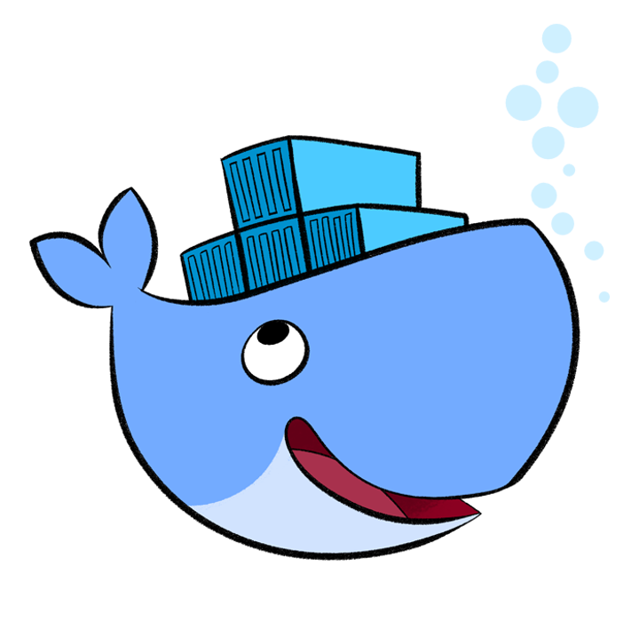
Installing Docker
With Docker 12 Linux, Mac, and Windows can all be installed directly.
However, your OS version matters!
You can also use Docker-Machine and Docker Toolbox to assist.
Or… you can
run it in a VM!
Powered by Virtuant © 2016
Notes:
container
A container is a runtime instance of a docker image.
A Docker container consists of
-A Docker image
-Execution environment
-A standard set of instructions
The concept is borrowed from Shipping Containers, which define a standard to ship goods globally. Docker defines a standard to ship software.
image
Docker images are the basis of containers. An Image is an ordered collection of root filesystem changes and the corresponding execution parameters for use within a container runtime. An image typically contains a union of layered filesystems stacked on top of each other. An image does not have state and it never changes.
tag
A tag is a label applied to a Docker image in a repository. tags are how various images in a repository are distinguished from each other.
Note : This label is not related to the key=value labels set for docker daemon
aufs
aufs (advanced multi layered unification filesystem) is a Linux filesystem that Docker supports as a storage backend. It implements the union mount for Linux file systems.
base image
An image that has no parent is a base image.
boot2docker
boot2docker is a lightweight Linux distribution made specifically to run Docker containers. The boot2docker management tool for Mac and Windows was deprecated and replaced by docker-machine which you can install with the Docker Toolbox.
btrfs
btrfs (B-tree file system) is a Linux filesystem that Docker supports as a storage backend. It is a copy-on-write filesystem.
build
build is the process of building Docker images using a Dockerfile. The build uses a Dockerfile and a “context”. The context is the set of files in the directory in which the image is built.
cgroups
cgroups is a Linux kernel feature that limits, accounts for, and isolates the resource usage (CPU, memory, disk I/O, network, etc.) of a collection of processes. Docker relies on cgroups to control and isolate resource limits.
Also known as : control groups
Compose
Compose is a tool for defining and running complex applications with Docker. With compose, you define a multi-container application in a single file, then spin your application up in a single command which does everything that needs to be done to get it running.
Also known as : docker-compose, fig
container
A container is a runtime instance of a docker image.
A Docker container consists of
A Docker image
Execution environment
A standard set of instructions
The concept is borrowed from Shipping Containers, which define a standard to ship goods globally. Docker defines a standard to ship software.
data volume
A data volume is a specially-designated directory within one or more containers that bypasses the Union File System. Data volumes are designed to persist data, independent of the container’s life cycle. Docker therefore never automatically delete volumes when you remove a container, nor will it “garbage collect” volumes that are no longer referenced by a container.
Docker
The term Docker can refer to
The Docker project as a whole, which is a platform for developers and sysadmins to develop, ship, and run applications
The docker daemon process running on the host which manages images and containers
Docker Hub
The Docker Hub is a centralized resource for working with Docker and its components. It provides the following services:
Docker image hosting
User authentication
Automated image builds and work-flow tools such as build triggers and web hooks
Integration with GitHub and Bitbucket
Dockerfile
A Dockerfile is a text document that contains all the commands you would normally execute manually in order to build a Docker image. Docker can build images automatically by reading the instructions from a Dockerfile.
filesystem
A file system is the method an operating system uses to name files and assign them locations for efficient storage and retrieval.
Examples :
Linux : ext4, aufs, btrfs, zfs
Windows : NTFS
macOS : HFS+
image
Docker images are the basis of containers. An Image is an ordered collection of root filesystem changes and the corresponding execution parameters for use within a container runtime. An image typically contains a union of layered filesystems stacked on top of each other. An image does not have state and it never changes.
libcontainer
libcontainer provides a native Go implementation for creating containers with namespaces, cgroups, capabilities, and filesystem access controls. It allows you to manage the lifecycle of the container performing additional operations after the container is created.
libnetwork
libnetwork provides a native Go implementation for creating and managing container network namespaces and other network resources. It manage the networking lifecycle of the container performing additional operations after the container is created.
link
links provide a legacy interface to connect Docker containers running on the same host to each other without exposing the hosts’ network ports. Use the Docker networks feature instead.
Machine
Machine is a Docker tool which makes it really easy to create Docker hosts on your computer, on cloud providers and inside your own data center. It creates servers, installs Docker on them, then configures the Docker client to talk to them.
Also known as : docker-machine
node
A node is a physical or virtual machine running an instance of the Docker Engine in swarm mode.
Manager nodes perform swarm management and orchestration duties. By default manager nodes are also worker nodes.
Worker nodes execute tasks.
overlay network driver
Overlay network driver provides out of the box multi-host network connectivity for docker containers in a cluster.
overlay storage driver
OverlayFS is a filesystem service for Linux which implements a union mount for other file systems. It is supported by the Docker daemon as a storage driver.
registry
A Registry is a hosted service containing repositories of images which responds to the Registry API.
The default registry can be accessed using a browser at Docker Hub or using the docker search command.
repository
A repository is a set of Docker images. A repository can be shared by pushing it to a registry server. The different images in the repository can be labeled using tags.
Here is an example of the shared nginx repository and its tags
service
A service is the definition of how you want to run your application containers in a swarm. At the most basic level a service defines which container image to run in the swarm and which commands to run in the container. For orchestration purposes, the service defines the “desired state”, meaning how many containers to run as tasks and constraints for deploying the containers.
Frequently a service is a microservice within the context of some larger application. Examples of services might include an HTTP server, a database, or any other type of executable program that you wish to run in a distributed environment.
service discovery
Swarm mode service discovery is a DNS component internal to the swarm that automatically assigns each service on an overlay network in the swarm a VIP and DNS entry. Containers on the network share DNS mappings for the service via gossip so any container on the network can access the service via its service name.
You don’t need to expose service-specific ports to make the service available to other services on the same overlay network. The swarm’s internal load balancer automatically distributes requests to the service VIP among the active tasks.
swarm
A swarm is a cluster of one or more Docker Engines running in swarm mode.
Swarm
Do not confuse Docker Swarm with the swarm mode features in Docker Engine.
Docker Swarm is the name of a standalone native clustering tool for Docker. Docker Swarm pools together several Docker hosts and exposes them as a single virtual Docker host. It serves the standard Docker API, so any tool that already works with Docker can now transparently scale up to multiple hosts.
Also known as : docker-swarm
swarm mode
Swarm mode refers to cluster management and orchestration features embedded in Docker Engine. When you initialize a new swarm (cluster) or join nodes to a swarm, the Docker Engine runs in swarm mode.
tag
A tag is a label applied to a Docker image in a repository. tags are how various images in a repository are distinguished from each other.
Note : This label is not related to the key=value labels set for docker daemon
task
A task is the atomic unit of scheduling within a swarm. A task carries a Docker container and the commands to run inside the container. Manager nodes assign tasks to worker nodes according to the number of replicas set in the service scale.
The diagram below illustrates the relationship of services to tasks and containers.
services diagram
Toolbox
Docker Toolbox is the installer for Mac and Windows users.
Union file system
Union file systems, or UnionFS, are file systems that operate by creating layers, making them very lightweight and fast. Docker uses union file systems to provide the building blocks for containers.
virtual machine
A virtual machine is a program that emulates a complete computer and imitates dedicated hardware. It shares physical hardware resources with other users but isolates the operating system. The end user has the same experience on a Virtual Machine as they would have on dedicated hardware.
Compared to containers, a virtual machine is heavier to run, provides more isolation, gets its own set of resources and does minimal sharing.

Slide 76
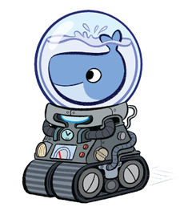
Docker Engine vs. Docker Machine
In older versions of Docker, you might have using “boot2docker” or “Docker Toolbox.”
Since Docker 12.1 however, we can work directly through our host.
Another way of installing and managing Docker on the host is Docker Machine.
Docker Machine links a host with a VM running in the background
Docker Engine creates, runs, and manages your containers
Powered by Virtuant © 2016

Slide 77
Basic Commands
In terminal, outside of a container…
See local repository of images
Check to see if containers are running
Pull a container down
Check system-wide information
$ docker images
$ docker ps
$ docker pull <reponame/imagename:tag>
$ docker info
https://docs.docker.com/engine/reference/commandline/
Powered by Virtuant © 2016

Slide 78
Basic Commands
How do we “get in” our container?
By spinning off an image using ‘run’
$ docker run <image-name, or image-id>
Container is running, but where is it?
Enter active containers with ‘exec -it’
$ docker exec -it <image-name, or image-id>
Powered by Virtuant © 2016

Slide 79
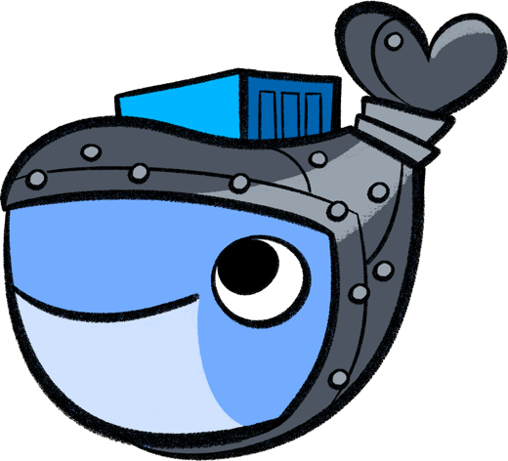
Basic Commands
You know you are “in” when you see…
root@<container-name, or container-id>
Now that we are “in” the container, we can use all our trusty Linux commands like, ll, cd, vi, and apt-get…
Look around and update
your system using apt-get
Powered by Virtuant © 2016

Slide 80
Basic Commands
When you first run an image you can:
Add ports, name the container, set hostname, select a network and more
We can also use ‘-it’ to “get in” to our container immediately
An example of how that might look:
$ docker run -it —-network networkname -p 8000 \
—-name name-container \
—-hostname name-host \
reponame/image-name:tag
Powered by Virtuant © 2016

Slide 81
Simple Exercise - Join In
Pull an Image down from Docker Hub:
$ docker pull busybox
Confirm image is in local repository:
$ docker images
Run container from new image and:
$ docker run -it busybox
Send a command from the inside:
# echo “Hello World!”
Powered by Virtuant © 2016

Slide 82
Web Server Exercise - Join In
Pull down a different image from the hub:
$ docker pull atbaker/nginx-example
Run the image and add ports on startup:
$ docker run -p 8000:80 atbaker/nginx-example
Host Port
Docker Port
Open an <localhost:8000>
Observe terminal as you refresh page
Powered by Virtuant © 2016

Slide 83
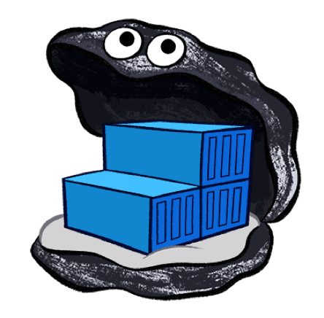
How do I save my work? You don’t!
You don’t save, you commit
$ docker pull <image-name>
Pull
Push
$ docker run -it <image-name:tag>
Image
Run
$ docker push <image-name:tag>
Commit
$ docker commit [OPTIONS] CONTAINER [REPOSITORY[:TAG]
Tag
$ docker tag <image-name> <image-name:tag>
Powered by Virtuant © 2016

Slide 84
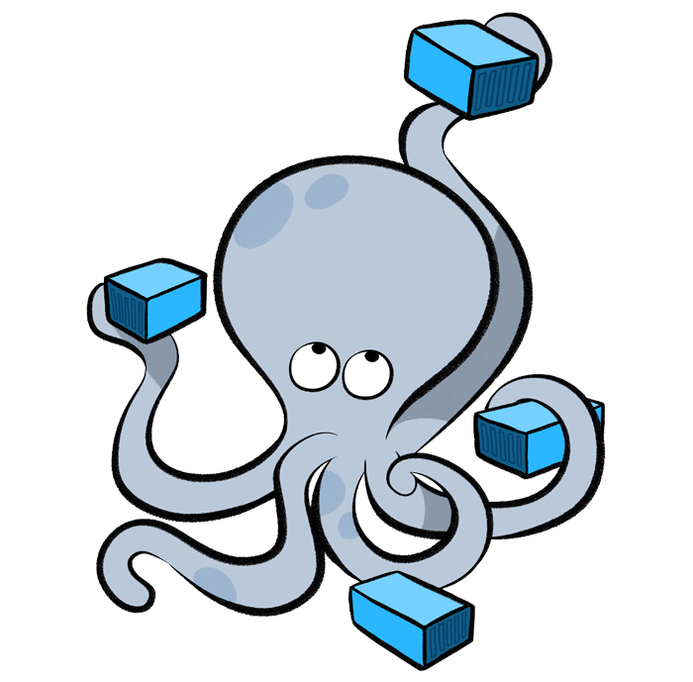
Other Docker Tools - Compose
A tool for defining and running multi-container Docker applications
Compose uses a YAML file to configure your application’s services
With a single command, create and start all the services
Production, staging, development, testing, as well as CI workflows
Using Compose is basically a three-step process:
Define app’s environment with a Dockerfile
Define the services in docker-compose.yml
Lastly, run docker-compose up
Powered by Virtuant © 2016

Slide 85
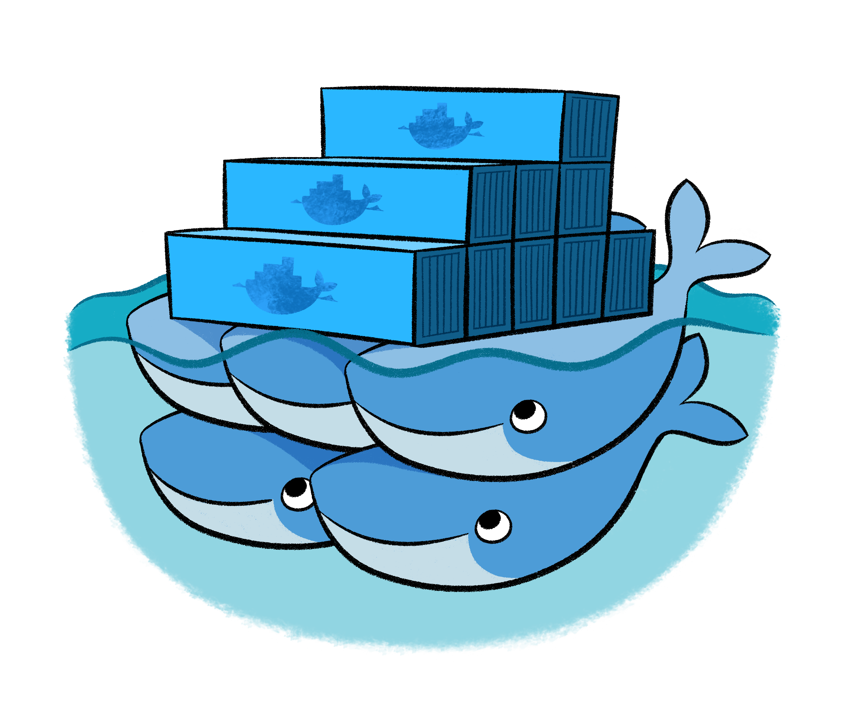
Other Docker Tools - Swarm
To use Docker in swarm mode; Docker 1.12.0 or later
Cluster of Docker Engines called a swarm
Use the Docker CLI to manage a Docker swarm
Feature Highlights
Load Balancing
Rolling Updates
State reconciliation
Cluster Management
Decentralized Design
Scaling
Powered by Virtuant © 2016
Notes:
Cluster management integrated with Docker Engine: Use the Docker Engine CLI to create a swarm of Docker Engines where you can deploy application services. You don’t need additional orchestration software to create or manage a swarm.
Decentralized design: Instead of handling differentiation between node roles at deployment time, the Docker Engine handles any specialization at runtime. You can deploy both kinds of nodes, managers and workers, using the Docker Engine. This means you can build an entire swarm from a single disk image.
Declarative service model: Docker Engine uses a declarative approach to let you define the desired state of the various services in your application stack. For example, you might describe an application comprised of a web front end service with message queueing services and a database backend.
Scaling: For each service, you can declare the number of tasks you want to run. When you scale up or down, the swarm manager automatically adapts by adding or removing tasks to maintain the desired state.
Desired state reconciliation: The swarm manager node constantly monitors the cluster state and reconciles any differences between the actual state and your expressed desired state. For example, if you set up a service to run 10 replicas of a container, and a worker machine hosting two of those replicas crashes, the manager will create two new replicas to replace the replicas that crashed. The swarm manager assigns the new replicas to workers that are running and available.
Multi-host networking: You can specify an overlay network for your services. The swarm manager automatically assigns addresses to the containers on the overlay network when it initializes or updates the application.
Service discovery: Swarm manager nodes assign each service in the swarm a unique DNS name and load balances running containers. You can query every container running in the swarm through a DNS server embedded in the swarm.
Load balancing: You can expose the ports for services to an external load balancer. Internally, the swarm lets you specify how to distribute service containers between nodes.
Secure by default: Each node in the swarm enforces TLS mutual authentication and encryption to secure communications between itself and all other nodes. You have the option to use self-signed root certificates or certificates from a custom root CA.
Rolling updates: At rollout time you can apply service updates to nodes incrementally. The swarm manager lets you control the delay between service deployment to different sets of nodes. If anything goes wrong, you can roll-back a task to a previous version of the service.

Slide 86
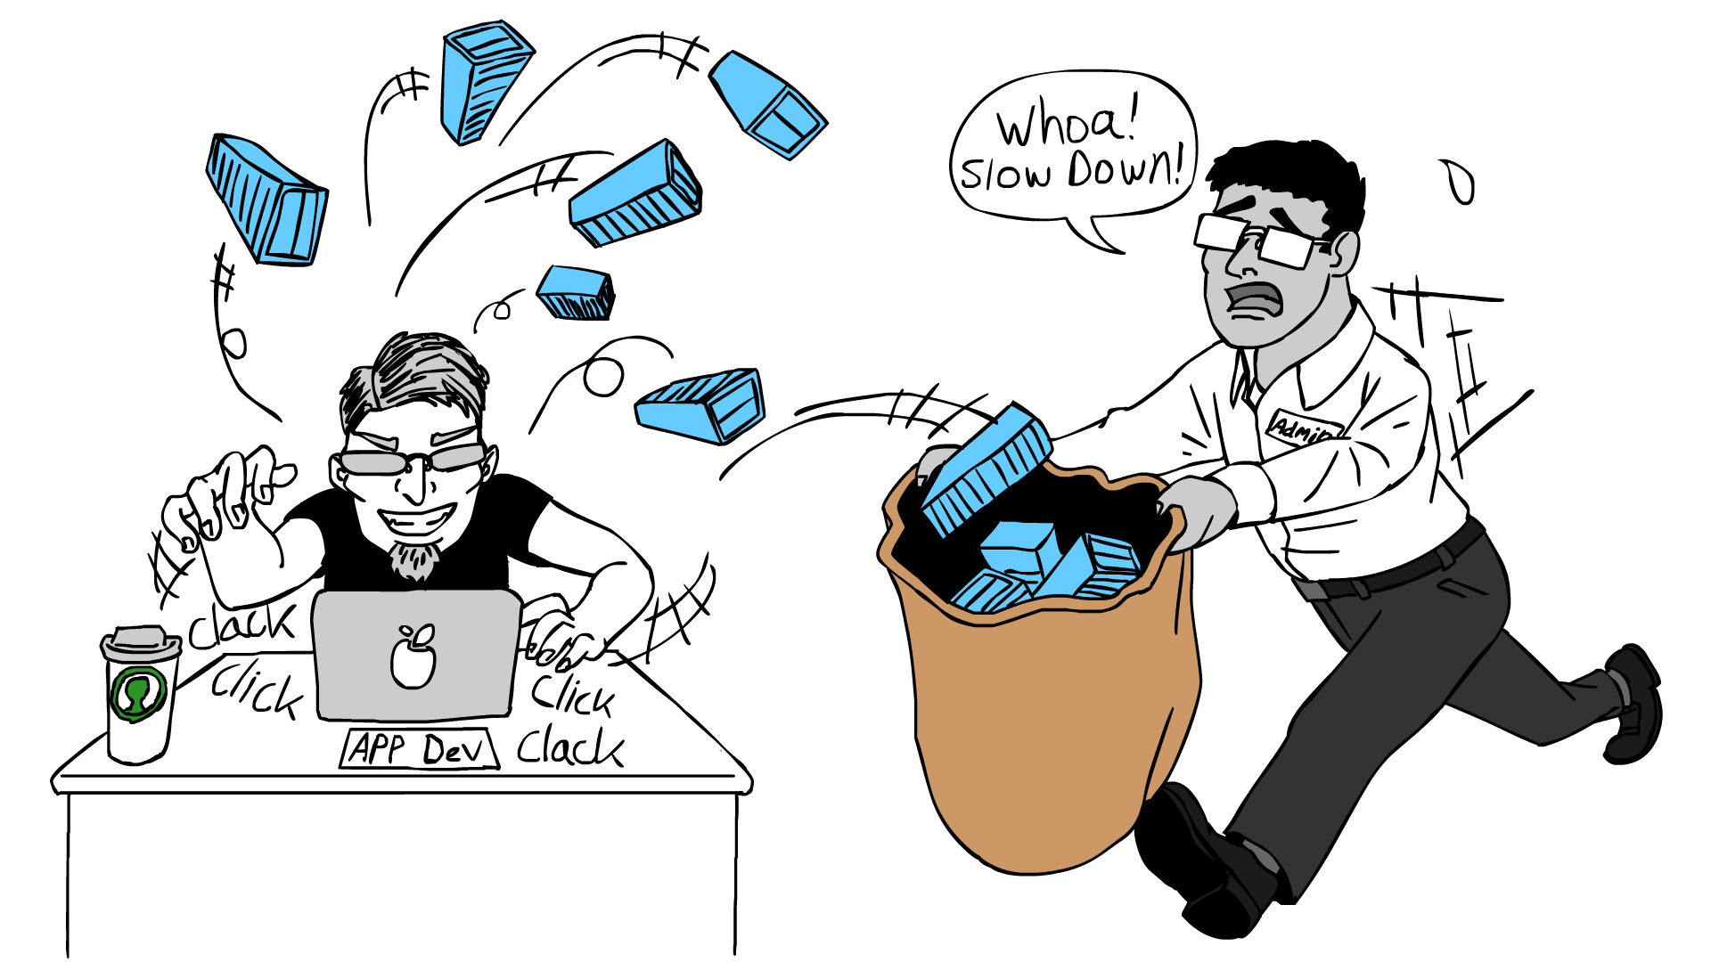

Slide 87
Lab Time
Enough talk, let’s do something!
Powered by Virtuant © 2016

Slide 88
End of Chapter
Powered by Virtuant © 2016

